Slide 1
Making Presentation-Quality Tables
May 7, 2019
J. Wolfand
Adapted from:
https://www.inf.ethz.ch/personal/markusp/teaching/guides/guide-tables.pdf
https://www.chicagomanualofstyle.org/home.html

Slide 2
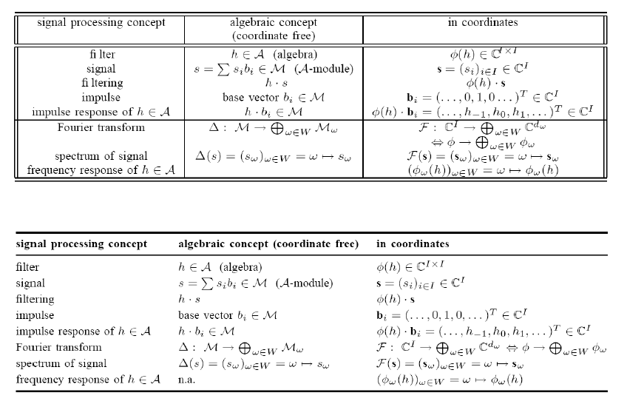
Which one looks better?

Slide 3
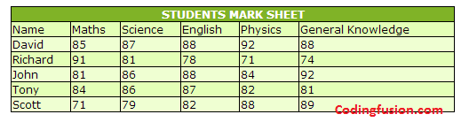
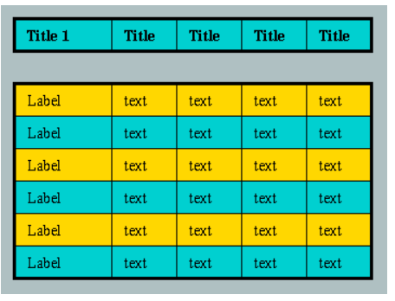
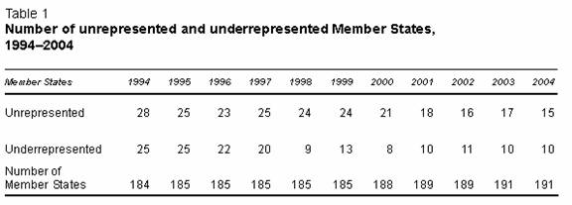
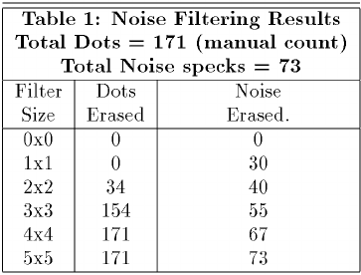
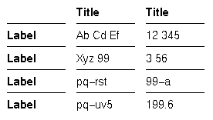
Which one looks best?

Slide 4
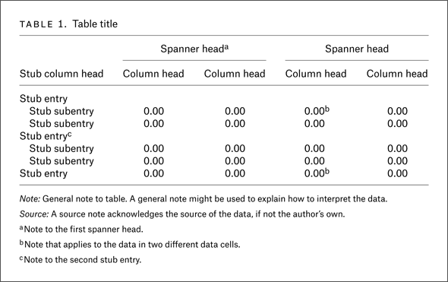
Chicago Manual of Style

Slide 5
No need for color
Company | Status | Value | Code | Cost
Google | Red | 59 | googl | $2394
Apple | Green | 504 | aapl | $359
Microsoft | orange | 300 | msft | $45
Company | Status | Value | Code | Cost
Google | Red | 59 | googl | $2394
Apple | Green | 504 | aapl | $359
Microsoft | orange | 300 | msft | $45

Slide 6
Remove vertical lines
Company | Status | Value | Code | Cost
Google | Red | 59 | googl | $2394
Apple | Green | 504 | aapl | $359
Microsoft | orange | 300 | msft | $45
Company | Status | Value | Code | Cost
Google | Red | 59 | googl | $2394
Apple | Green | 504 | aapl | $359
Microsoft | orange | 300 | msft | $45

Slide 7
Remove horizontal lines between data
Company | Status | Value | Code | Cost
Google | Red | 59 | googl | $2394
Apple | Green | 504 | aapl | $359
Microsoft | orange | 300 | msft | $45
Company | Status | Value | Code | Cost
Google | Red | 59 | googl | $2394
Apple | Green | 504 | aapl | $359
Microsoft | orange | 300 | msft | $45

Slide 8
Enough space between rows
Company | Status | Value | Code | Cost
Google | Red | 59 | googl | $2394
Apple | Green | 504 | aapl | $359
Microsoft | orange | 300 | msft | $45
Company | Status | Value | Code | Cost
Google | Red | 59 | googl | $2394
Apple | Green | 504 | aapl | $359
Microsoft | orange | 300 | msft | $45

Slide 9
Left align dimensions, right or center align data
Company | Status | Value | Code | Cost
Google | Red | 59 | googl | $2394
Apple | Green | 504 | aapl | $359
Microsoft | orange | 300 | msft | $45
Company | Status | Value | Code | Cost
Google | red | 59 | googl | $2394
Apple | green | 504 | aapl | $359
Microsoft | orange | 300 | msft | $45

Slide 10
Left align dimensions, right or center align data
Company | Status | Value | Code | Cost
Google | Red | 59 | googl | $2394
Apple | Green | 504 | aapl | $359
Microsoft | orange | 300 | msft | $45
Company | Status | Value | Code | Cost
Google | red | 59 | googl | $2394
Apple | green | 504 | aapl | $359
Microsoft | orange | 300 | msft | $45

Slide 11
Simple guidelines
No need for color
Avoid vertical lines
Avoid “boxing up” cells, usually 3 horizontal lines are enough
Avoid double horizontal lines
Enough space between rows
Left align dimensions, right or center align data
Pay attention to significant digits
Notes:
https://www.amazon.com/dp/0970601999/?tag=stackoverflow17-20

Slide 12
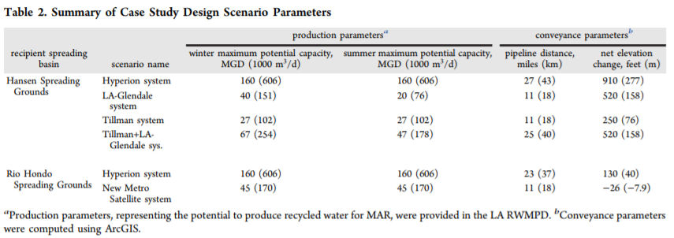
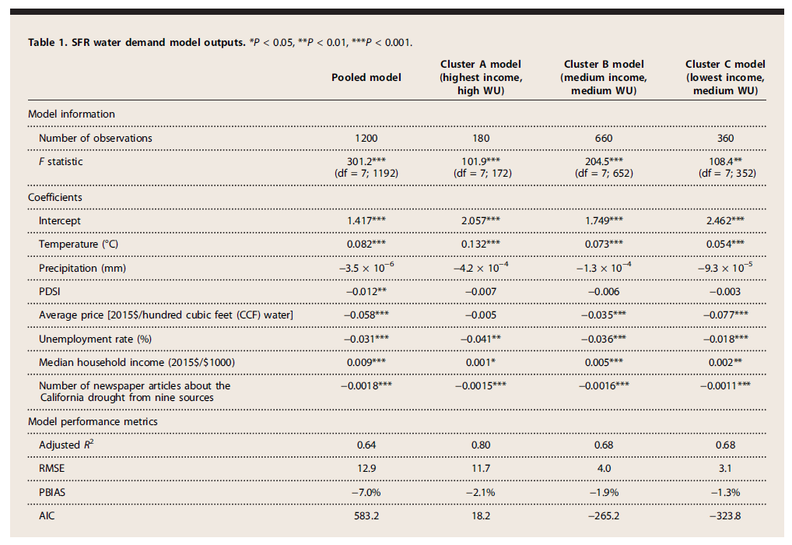
Generally publications will use their own style

Slide 13
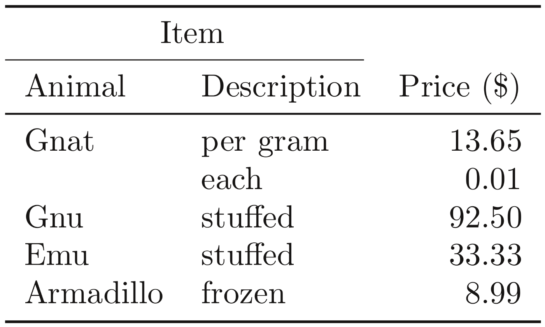
In LaTeX
Style: \usepackage{booktabs}

